Slide 1
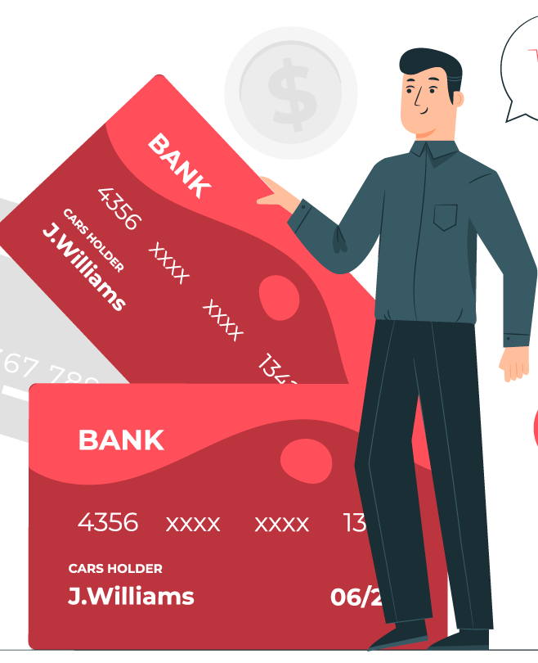
CREDIT CARD ANALYSIS REPORT
VIKASINI D​

Slide 2
KEY SEGMENTS
1
2
3
4
5
Project Overview
Data Extraction
Data Processing and DAX queries
Dashboard
Insights

Slide 3

PROJECT OVERVIEW :
In today’s digital economy, credit card transactions generate massive volumes of real-time financial data.
Transforming this raw data into meaningful insights is critical for financial institutions to enhance decision-making, manage risk, and improve customer experience.
This project focuses on developing an interactive Credit Card Transaction Analysis Dashboard using Microsoft Power BI, aimed at uncovering spending patterns, revenue trends and customer behavior.

Slide 4
DATA EXTRACTION:
Firstly, collected the dataset from Kaggle in csv form.
Created columns in SQL in order to accommodate the data.
Imported the csv file into SQL.

Slide 5
DATA PROCESSING AND DAX QUERIES:
Using Power Query,
✔ Handled Missing Values (Replaced missing categories with “Unknown”)
✔ Data Type Transformation
✔ Removing Duplicates
Using DAX queries,
Created new columns like Revenue ( by adding all the income streams ) and Income slabs (High, med, low) and Age groups (20-30, 30-40,…)

Slide 6
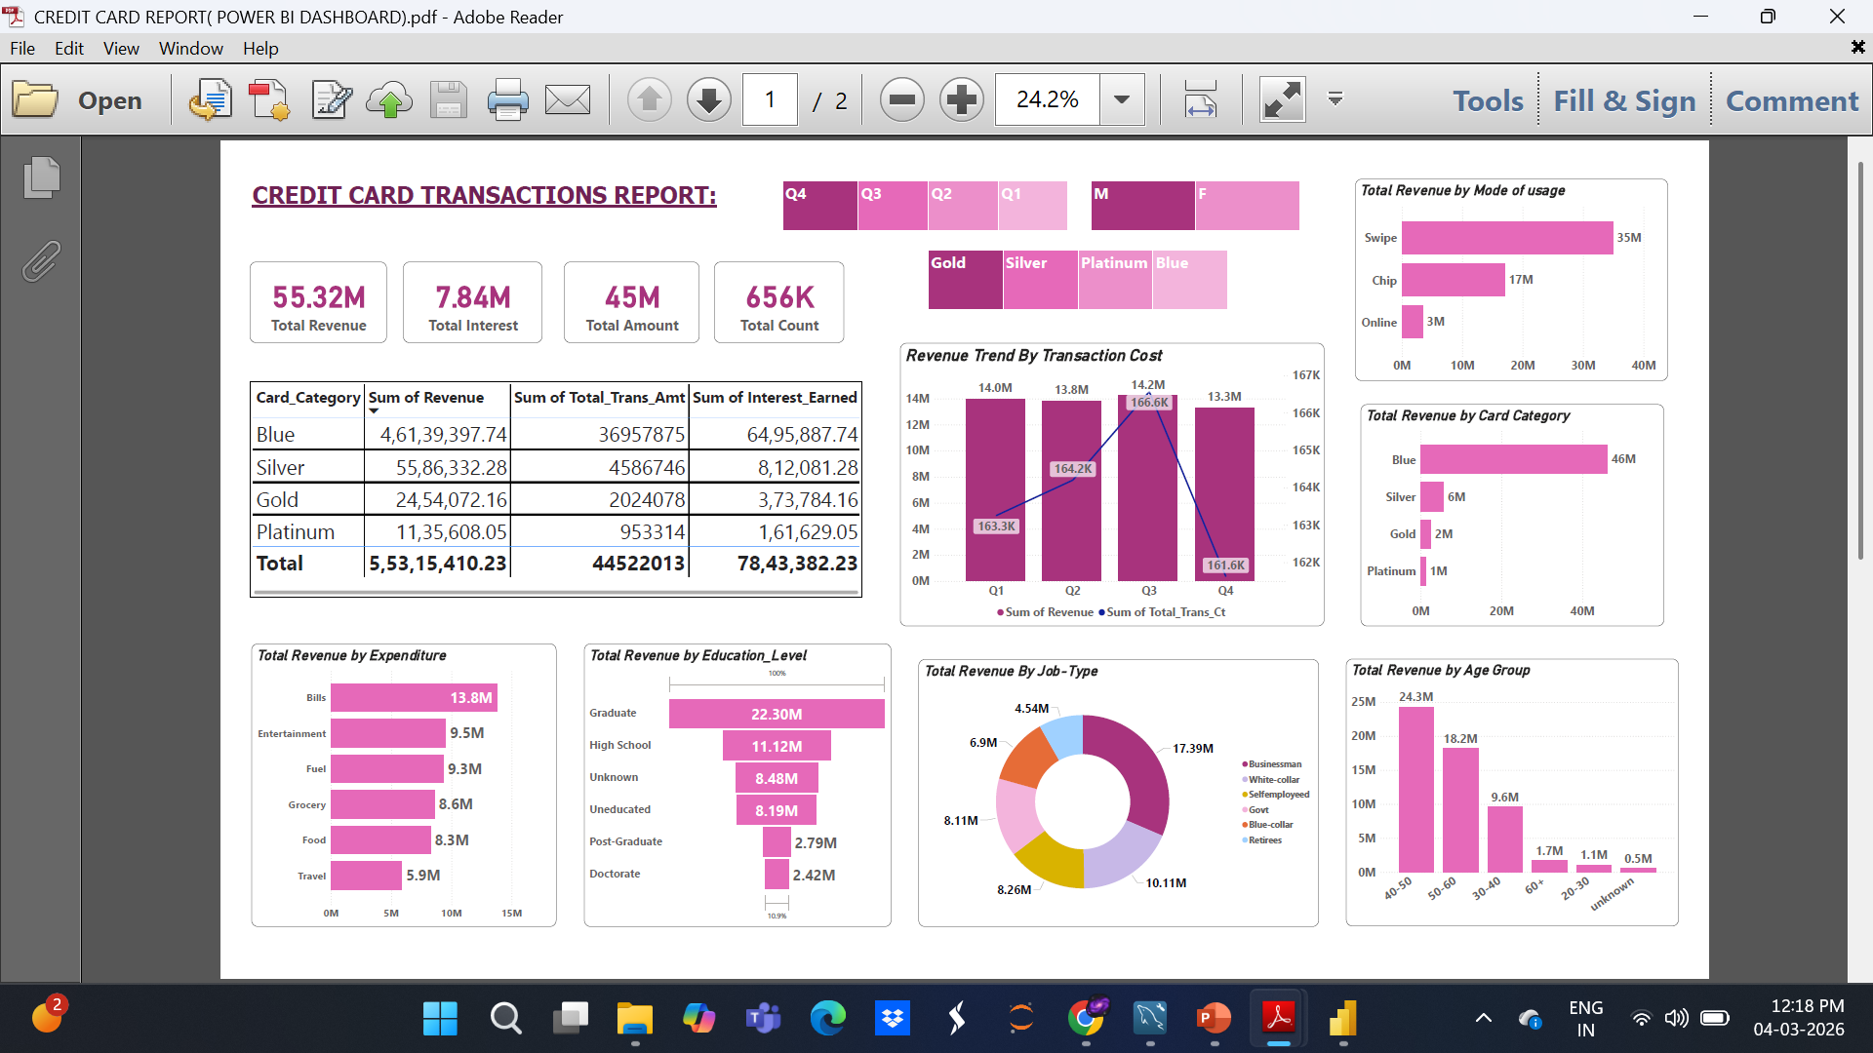
DASHBOARDS:

Slide 7
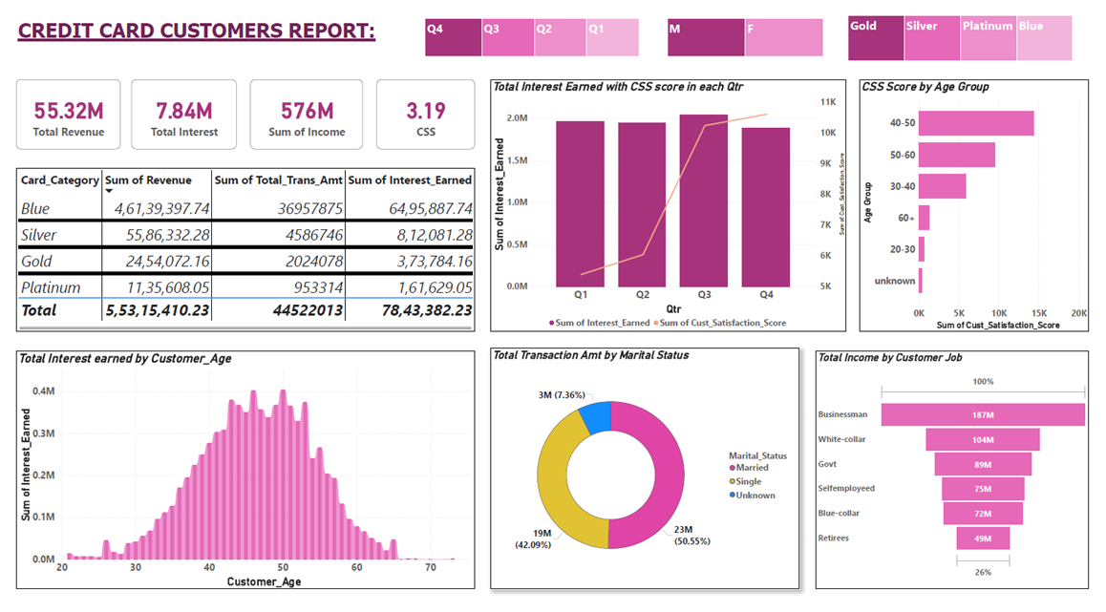

Slide 8





GENERAL INSIGHTS:
Total Revenue
55.3M
Total Interest
7.8M
Total Amount
45M
Total Transaction Count
656K
Overall Activation rate is 57.5%
Overall Delinquent rate is 6.06%

Slide 9
INSIGHTS WITH CREDIT CARD TRANSACTIONS:
With respect to
Card-type,
Age --->
Blue cards dominate the portfolio, contributing ~83% of total revenue.
Swipe transactions dominate usage (~63% of revenue).
Middle-aged customers (40–50) generate the most spending
With respect to
Utility and
Education -->
Bills are the largest spending category, meaning cards are heavily used for utility payments.
Highly educated groups (Post-graduate & Doctorate) contribute much less, possibly due to smaller population segments.

Slide 10
INSIGHTS WITH CREDIT CUSTOMERS:
CSS( CUSTOMER SATISFACTION SCORE):
SPENDING:
INTEREST EARNING:
✔ Middle-aged customers (40–50) are the most valuable segment. ✔ Married customers spend more than single customers. ✔ Business professionals contribute the highest income levels.
Interest earnings increase from age 30 to 50.
Peak earnings occur between ages 45–50.
After age 55, interest contribution gradually declines.
The portfolio generates strong revenue, but the customer satisfaction score is moderate, indicating room for improvement in customer experience. ​

Slide 11

BUSINESS SUGGESTIONS:
Promoting Gold and Platinum cards to increase premium segment revenue.
Encouraging online payments with cashback or reward programs.
Could Launch youth-focused credit cards to increase usage in the 20–30 segment.
Offering travel rewards to boost travel category spending.
Target business professionals and graduates with tailored credit card offers.
Improving customer satisfaction through better rewards, services, and support.

Slide 12

Thank you!
VIKASINI D
vikasinidevaraj.08@gmail.com

